Slide 1
AI in MLM Software: Transforming Direct Selling with Intelligence
Focus: Lead Scoring, Churn Prediction & Chatbots

Slide 2
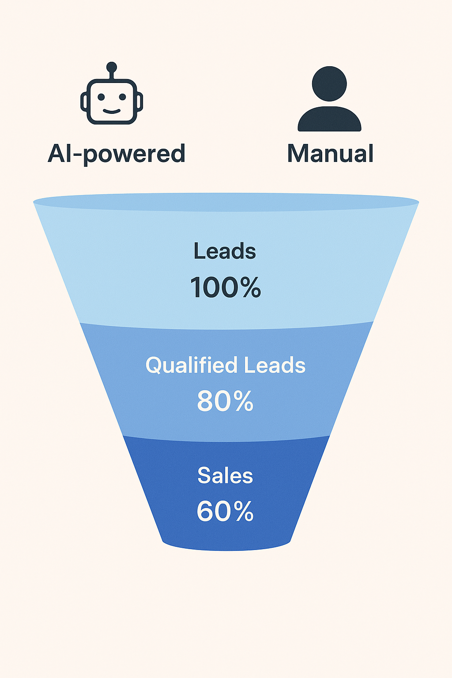
Lead Scoring & Churn Prediction
AI predictive lead scoring identifies high-value prospects and prioritizes distributor engagement. Churn prediction reduces attrition by highlighting at-risk reps.

Slide 3
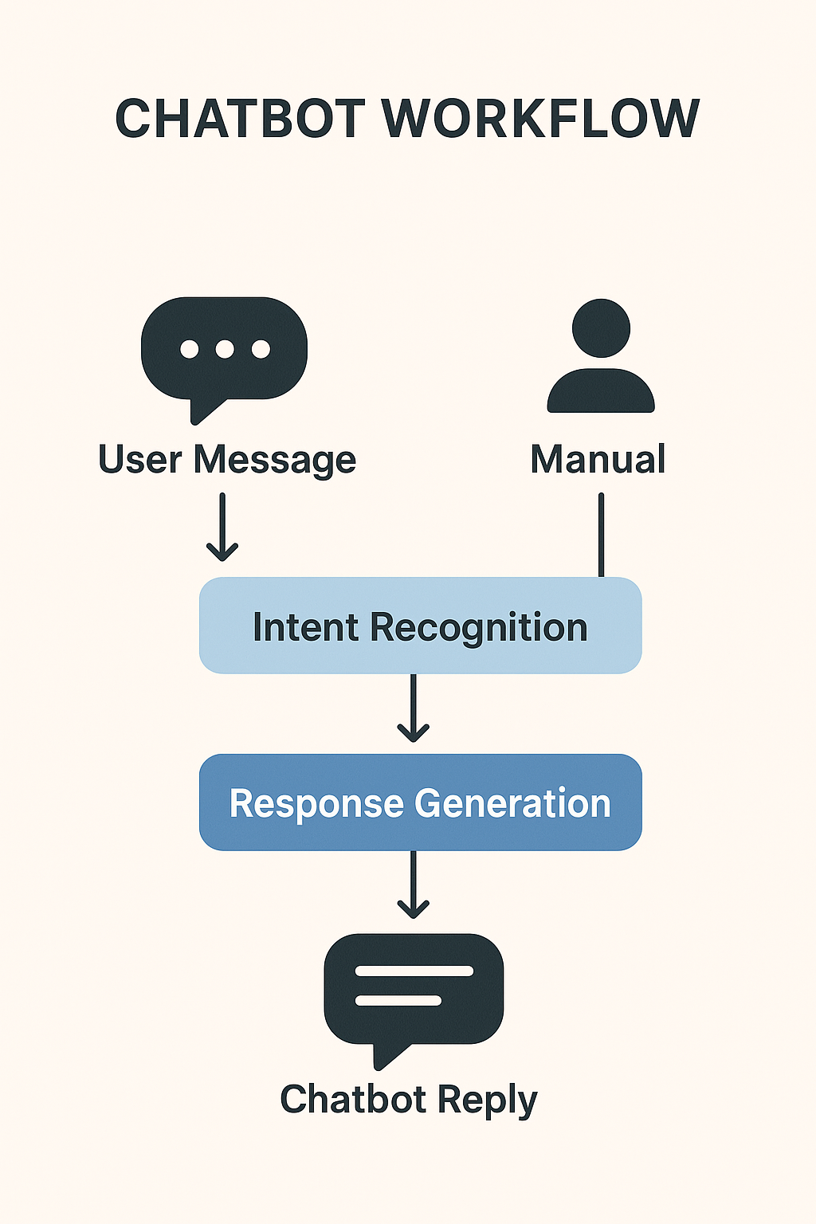
Chatbots for Rep FAQs & Onboarding
Chatbots provide 24/7 FAQ support, onboarding tutorials, and motivation nudges. They reduce reliance on uplines and improve distributor retention.

Slide 4
Churn Prediction Dashboard
AI churn dashboards flag reps at risk of leaving based on engagement metrics. This enables proactive retention strategies.

Slide 5
Conclusion
AI revolutionizes MLM by boosting lead conversion, reducing churn, and empowering distributors through chatbots. Early adopters gain long-term competitive advantage.

